Slide 1

Dreamkey Custom SDK
Elliott Martin
DTS Software Engineer
Sega Europe
dts@soe.sega.co.uk
martine@soe.sega.co.uk

Slide 2
Overview
Introduction
Creating a browser
Directory Structure
Launching from an application
Browser plug-ins
The VM unit
Customisation
Textures and layout
Audio and Video
Sega Strictly Confidential

Slide 3
Introduction
What is ‘Dreamkey Custom’?
  Incorporate Dreamkey browser and email technology into your Dreamcast games.
What standard features are supported?
  HTML 3.2 compliant.
  HTML frames.
  Secure Socket Layer (SSL).
  Javascript 1.1.
  Macromedia Flash 3.
Sega Strictly Confidential

Slide 4
Creating a browser
No direct programming involved. Use ‘.ini’ and script files to set-up browser:
  dp2.ini - Main script file. Customise all game specific functionality of browser.
  message.ini - Customise message prompts and info presented to user during browser use.
  dp2.dps - Customise appearance of menus and dialog boxes in browser.
  softkey.dps - Customise appearance of software keyboard.
  vms.dps - Customise appearance of VM management screen.
Sega Strictly Confidential

Slide 5
Directory structure
\gd_root
\dpetc - Location of browser script files.
\dpfont - Location of browser fonts.
\dpmodel - Unused, but must be present.
\dpss - Location of screen saver pics.
\dptex - Location of GUI texture files.
\dpwww - Location of local HTML files.
2_dp.bin - Dreamkey Custom executable.
maigo.bin - Application recovery file.
sg_dpldr.bin - File for reading Dreamkey.
dp2.ini - Browser configuration file.
. . .
. . . Remaining game data . . .
Sega Strictly Confidential

Slide 6
Launching from app
Start-up your application as normal (system init, cable check, etc.)...
Verify that the user has registered with Dreamkey before:
  rc = ntInfIsNetworkInfo();
Check to see if the user has chosen to enter the Dreamkey browser...
Call the following function to switch control to the Dreamkey browser:
  SwitchToPassport();
Sega Strictly Confidential

Slide 7
Browser plug-ins
Vibration pack plug-in
  Trigger the vibration pack to rumble when a web page is accessed. All properties can be customised as in PDS_VIBPARAM (pdVibStart API).
Model viewer plug-in
  Display standard Ninja model and animation files as part of your web page (applies to ‘.NJ’ and ‘.NJM’ files).
VM image plug-in
  Display simple monochrome images on the LCD display of a VM (as in the pdVmsLcdWrite API).
VM ticker plug-in
  Scroll a line of text across the LCD display of a VM (the scrolling properties can be easily customised).
Sega Strictly Confidential

Slide 8
VM downloads
Downloading files from a web site to a VM:
  .VMS file - Actual file data for saving in the VM.
  .VMI file - Info about the data in the .VMS file.
  Application based files can be pre-prepared using the txt2vmi tool.
  The URL must point to the .VMI info file, NOT the .VMS data file.
  User-uploaded files must have the .VMI file created by a CGI program prior to downloading.
Sega Strictly Confidential

Slide 9
VM uploads
Uploading files from a VM to a web site:
  The file’s copy flag must be set to copy enable to allow other users to download the file again.
  The file data must be decoded by a CGI program on the server (all uploaded files are encoded using a special variation of base64).
  Only one VM file upload can be set per web page (including frame-based pages).
Sega Strictly Confidential

Slide 10
The VM process
Client application creates a VM file...
Add required data with CGI program and create VMI file...
Upload...
Download...
Decode encoded data using CGI...
Save on VM (overwriting any files with the same name).
Save uploaded data using .VMS name...
Sega Strictly Confidential

Slide 11
Customising dp2.ini
Change and customise multiple features:
  System settings
    Name and location of Dreamkey set-up files on the GD-ROM.
    Name and location of screen saver images on the GD-ROM.
    Audio set-up (sound driver / sound effects file / ‘voice guidance’ file).
  Browser settings
    User-agent or browser type (i.e. Mozilla/3.0 (Dream Key; SEGA/Custom)).
    Specify the product home page (accessible from the browser’s L/R menu).
    Default function key assignments (E.g. F1 = ‘www.’, F2 = ‘.com’, etc.).
Sega Strictly Confidential

Slide 12
Customising dp2.ini
  Email settings
    ‘XMailer’ identity (I.e. ‘DreamKey’). Stored in the email header.
    Attachment filtering (exclude or allow sending of specific files).
  Help settings
    Location of help info on the GD-ROM for each language region.
  Regional settings
    Specify a language dependent front page for each language region.
Sega Strictly Confidential

Slide 13
Textures / Layout
Customise the appearance of Dreamkey to fit the style of your game.
All script files are basic text files and use the same language format as HTML (i.e. tags).
Menu options: (as specified in ‘dpetc\dp2.dps’)
  Customise the appearance of the L/R trigger menus.
  Add/remove menu options.
Dialog appearance: (as specified in ‘dpetc\dp2.dps’)
  Change the visual style of dialog boxes and other common controls.
User feedback: (as specified in ‘dpetc\message.ini’)
  Change the messages presented to the user during browser use.
  The number value of the message MUST NOT be changed, only the text.
Sega Strictly Confidential

Slide 14
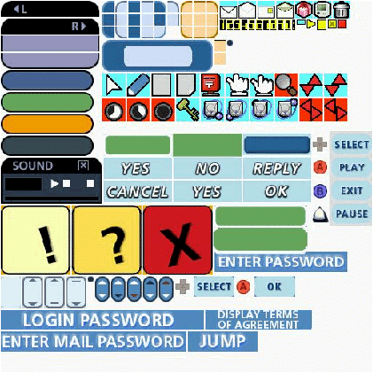
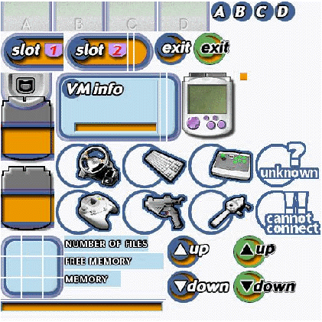
Texture examples
<define-tex id=2 path='jyoucyu0.pvr' width=512 height=512 group='persistent'>
<define-tex id=9 path='vmsparts.pvr' width=512 height=512 group='vms'>
dptex\jyoucyu0.pvr dptex\vmsparts.pvr
Sega Strictly Confidential

Slide 15
Audio and video
Play audio straight from a web site and stream video off the GD-ROM…
  Supported file formats:
    MIDI, AU, AIFF, WAV, MPEG/Sofdec and ADX.
  Playing audio files from a web site (download limitations):
    MIDI files up to 80KB in size.
    AU, AIFF and WAV files up to 200KB in size.
    NO LIMIT for audio files stored on GD-ROM.
  Streaming video:
    MPEG - x-avefront://---.dream/proc/play/mpeg/<GD file path>
    ADX - x-avefront://---.dream/proc/play/adx/<GD file path>
Sega Strictly Confidential

Slide 16
Q & A
Q&A?

